Slide 1
Topic: Quadratics
Year 10 Mathematics
EQ – How can the parabola be transformed?

Slide 2
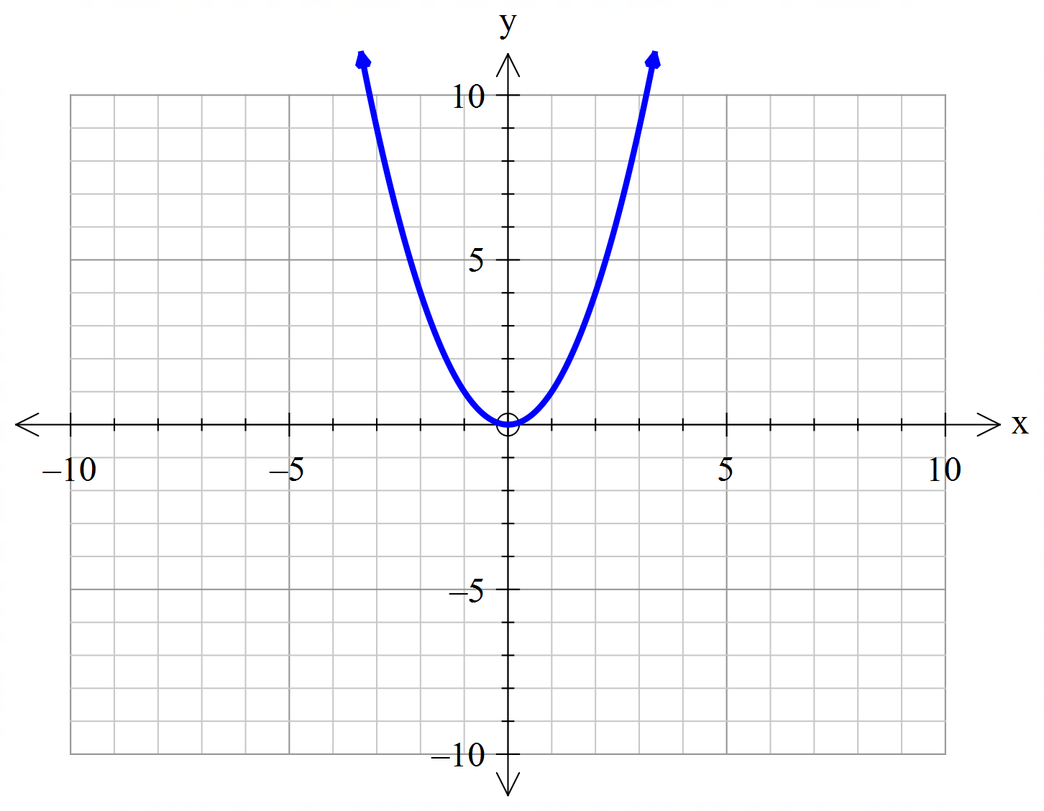
24
7
30
Topic: Quadratics
Date:
EQ – How can the parabola be transformed?
What is transformation?
Transformations in mathematics involves, reflection, translation, and dilation. These can be applied to parabolas
What is the simplest parabola?
The simplest parabola is $y=x^{2}$ and this is what will be transformed

Slide 3
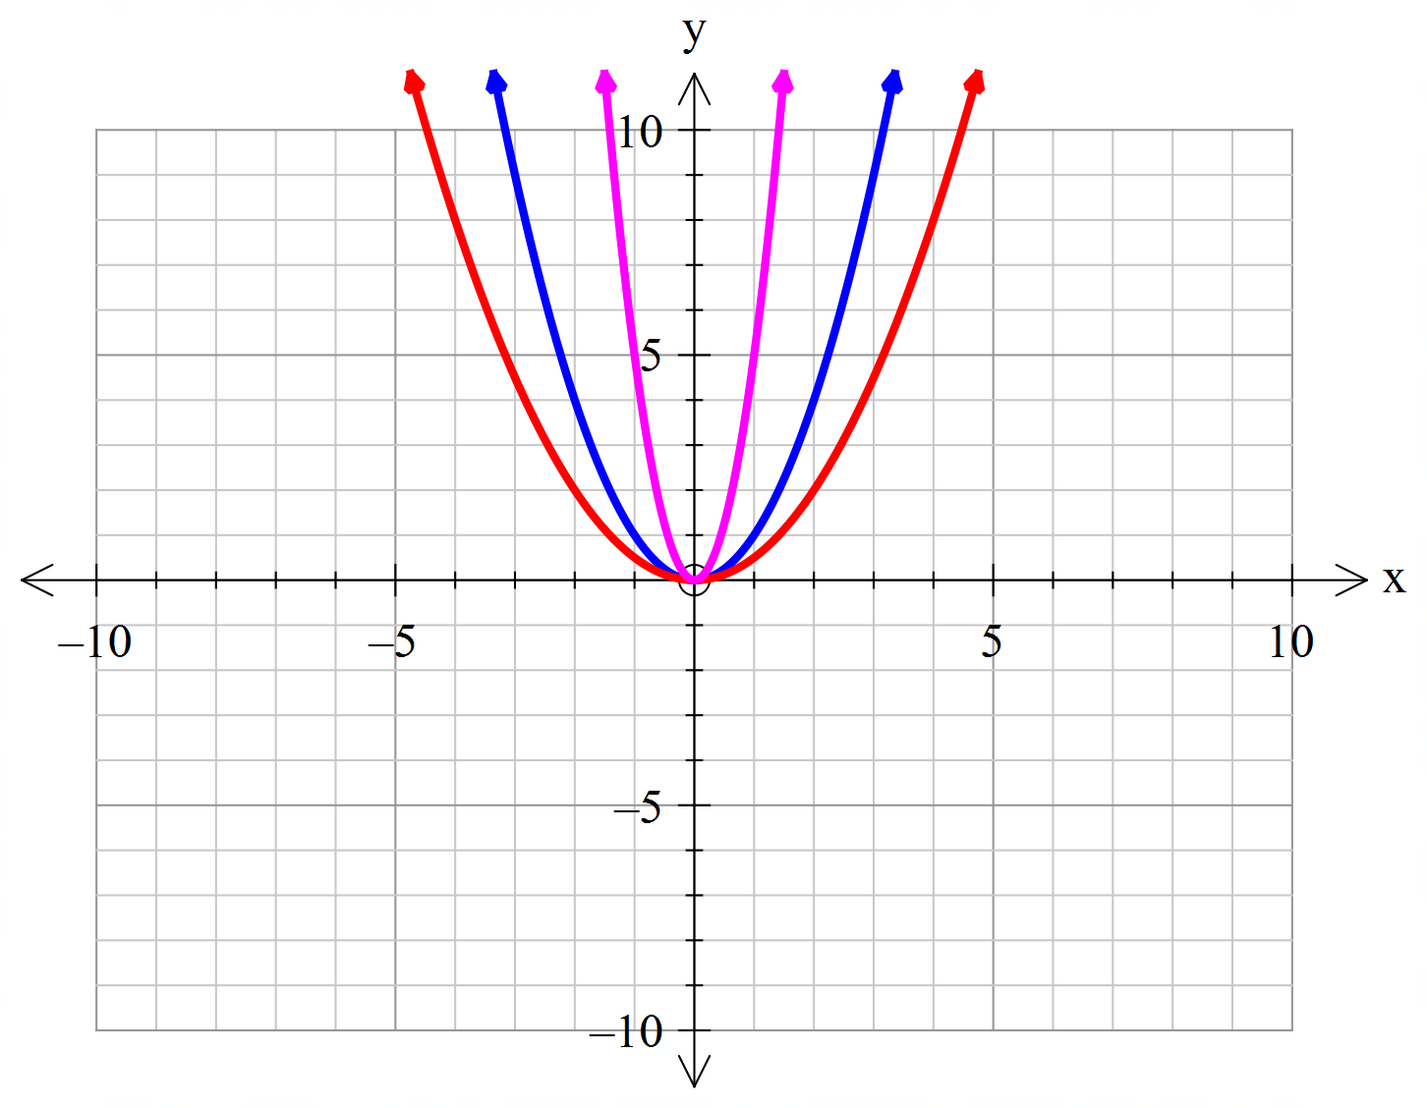
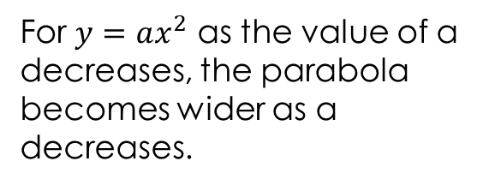
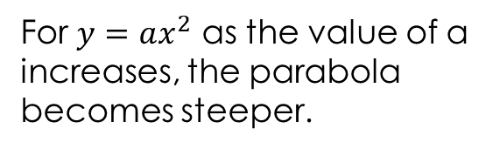



24
7
30
Topic: Quadratics
Date:
EQ – How can the parabola be transformed?
How do we dilate or reduce a parabola?
$$y=5x^{2}$$
For $y=ax^{2}$ as the value of a increases, the parabola becomes steeper.
$$y=x^{2}$$
$$y={\frac{1}{2}x}^{2}$$
For $y=ax^{2}$ as the value of a decreases, the parabola becomes wider as a decreases.

Slide 4
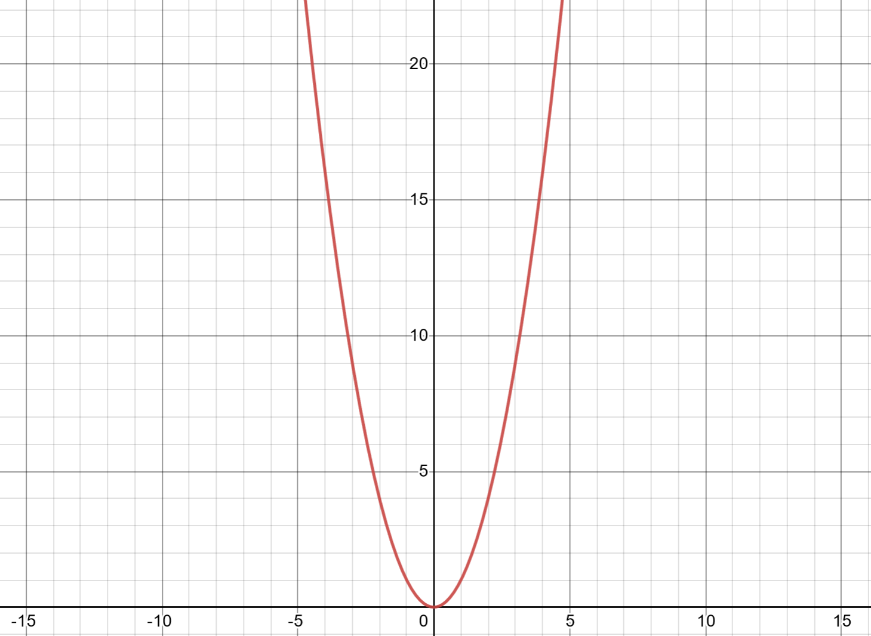
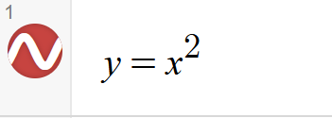
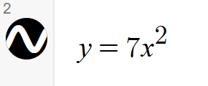
Will the above equation be steeper or wider?

Slide 5
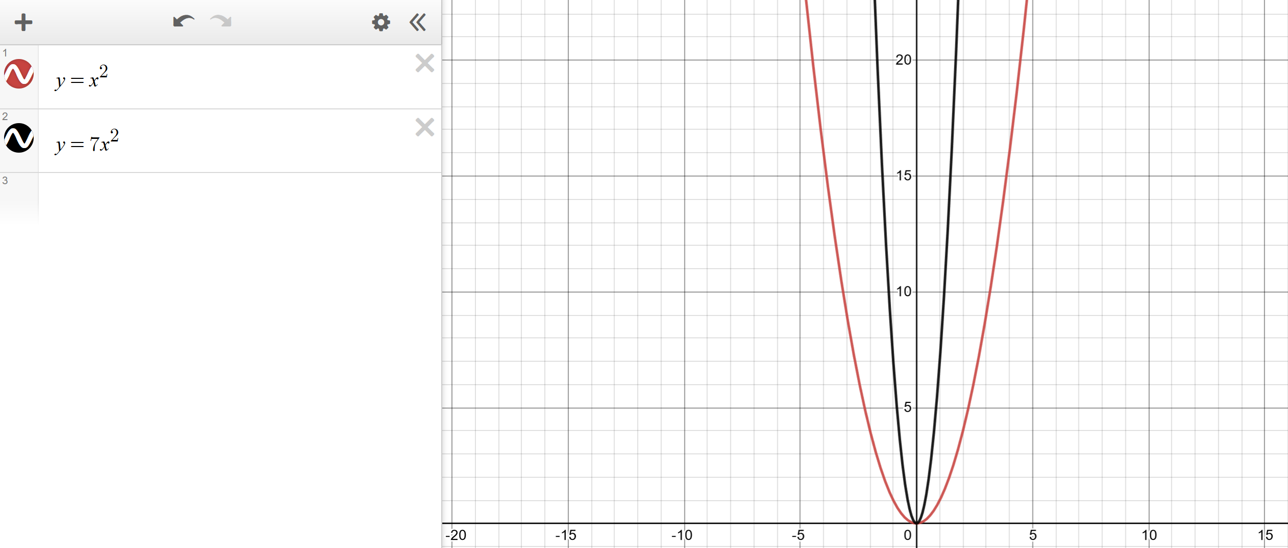
SOLUTIONS

Slide 6
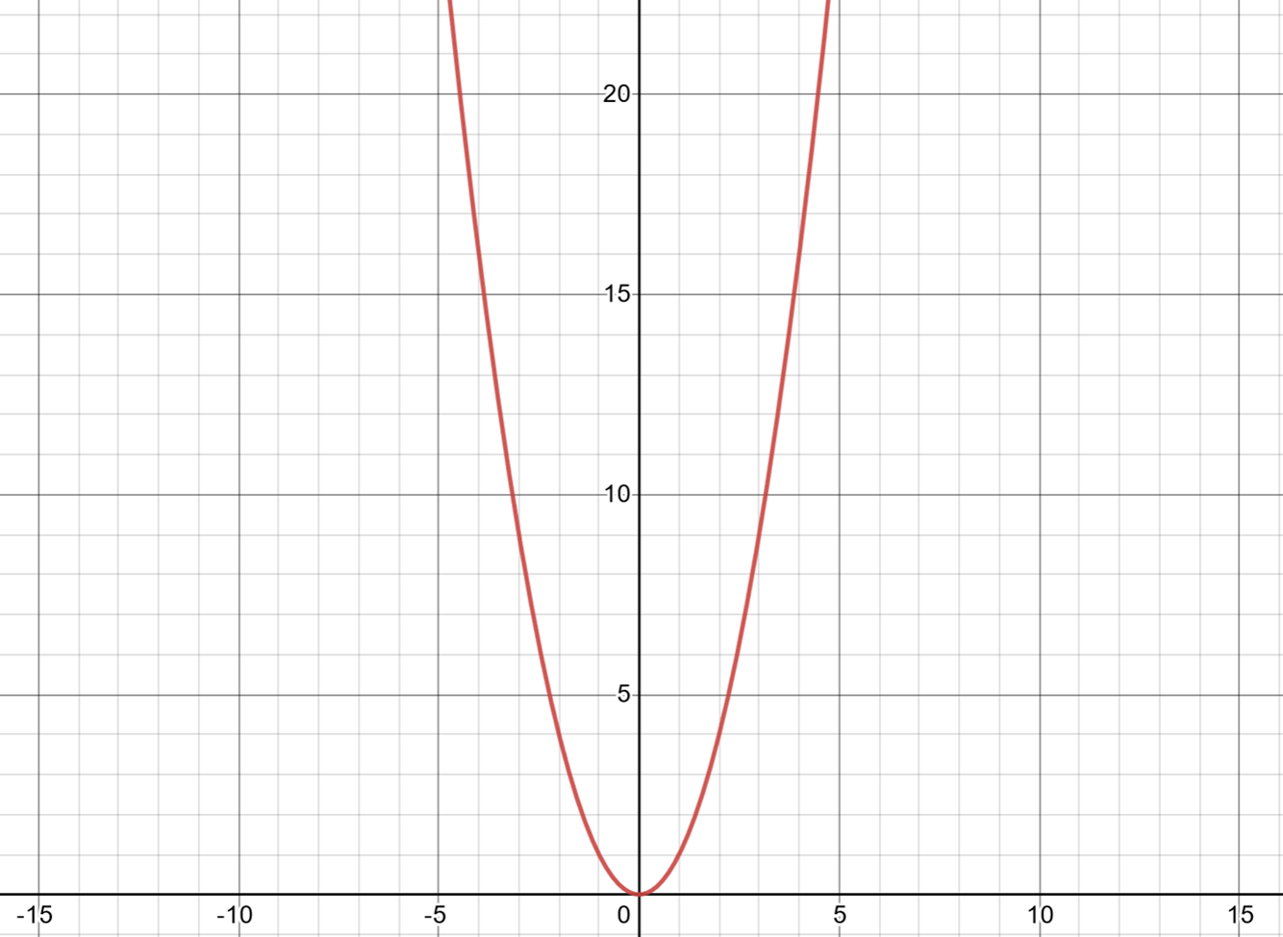
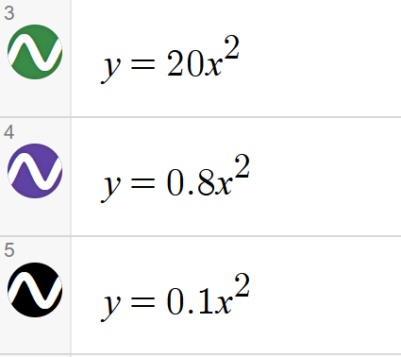
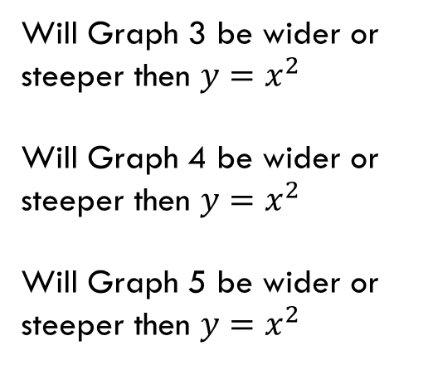
Will Graph 3 be wider or steeper then $y=x^{2}$
Will Graph 4 be wider or steeper then $y=x^{2}$
Will Graph 5 be wider or steeper then ${y=x}^{2}$

Slide 7
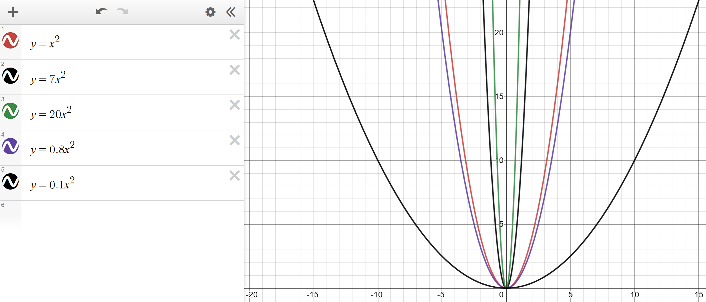

Slide 8
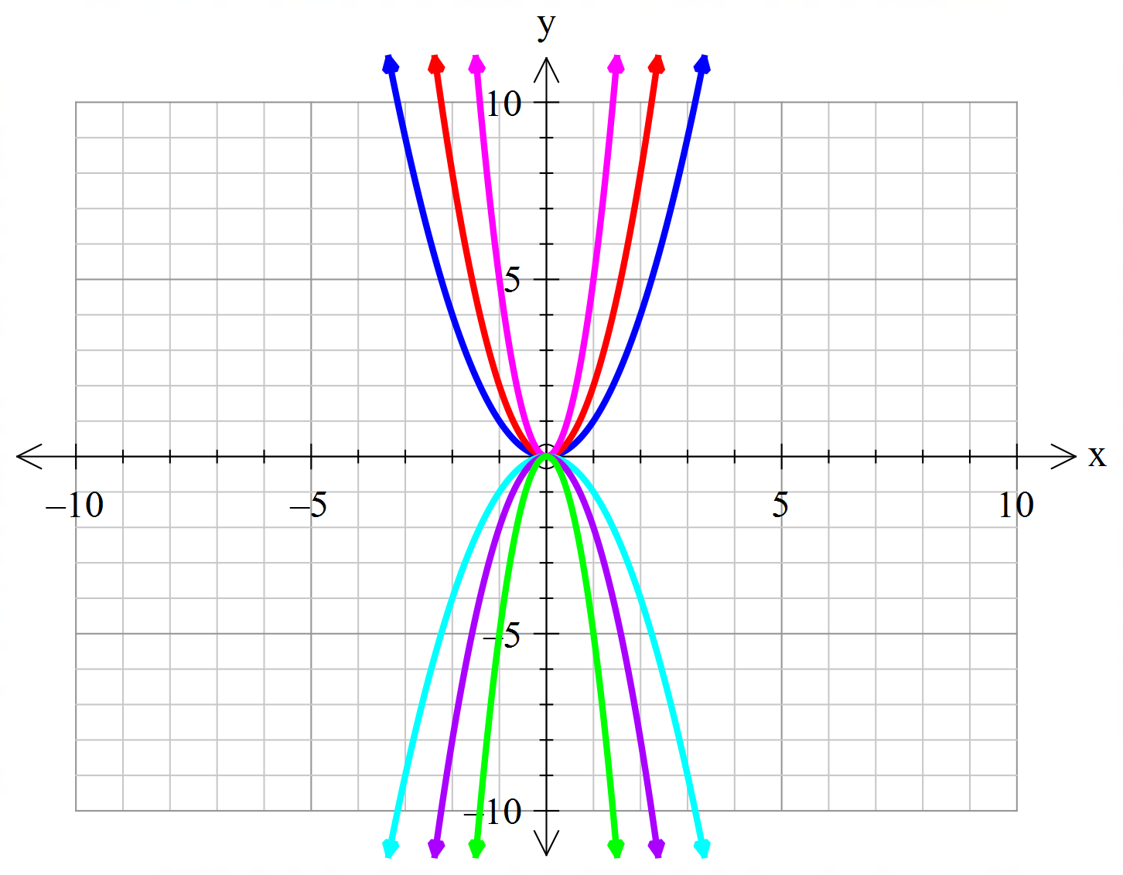



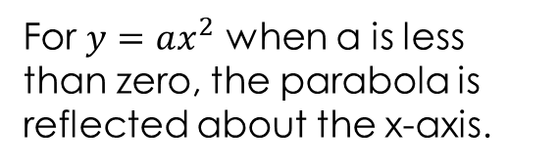


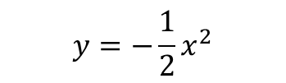
24
7
30
Topic: Quadratics
Date:
EQ – How can the parabola be transformed?
How do we reflect a parabola about the x-axis?
$$y=x^{2}$$
For $y=ax^{2}$ when a is less than zero, the parabola is reflected about the x-axis.
$$y={5x}^{2}$$
$$y={\frac{1}{2}x}^{2}$$
$$y={−x}^{2}$$
$$y={−5x}^{2}$$
$$y={−\frac{1}{2}x}^{2}$$

Slide 9
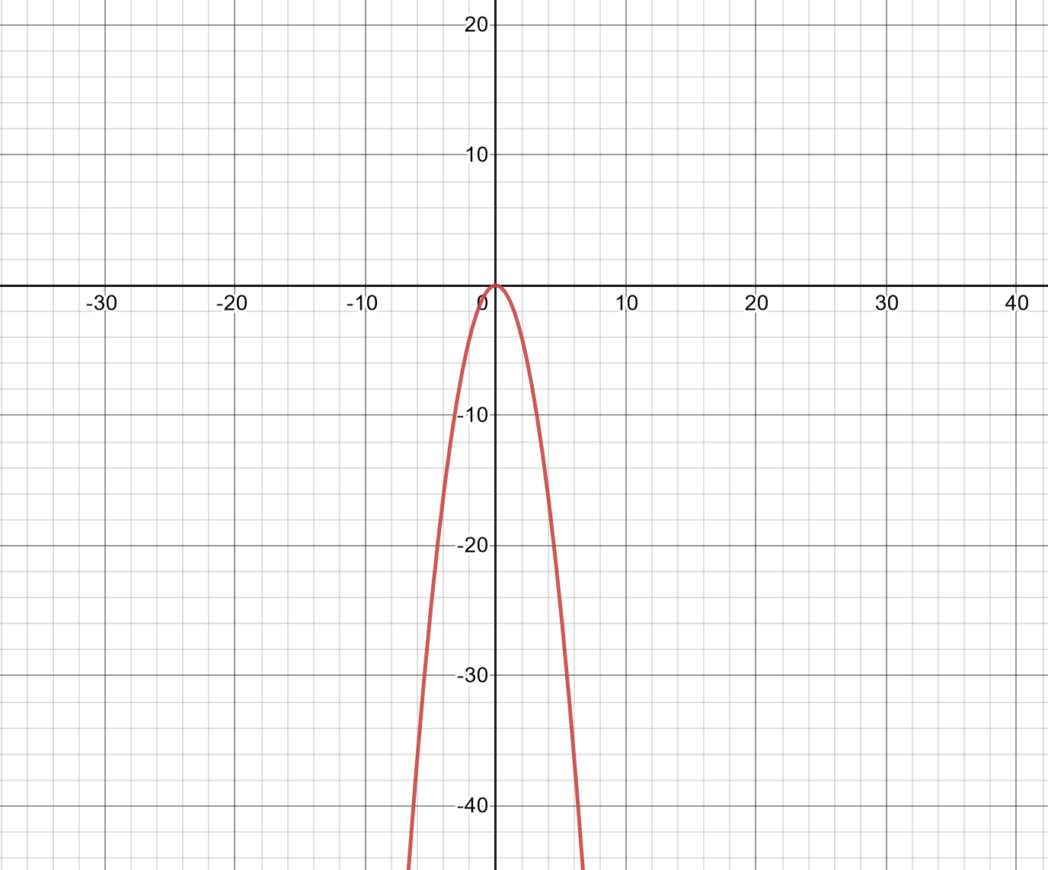

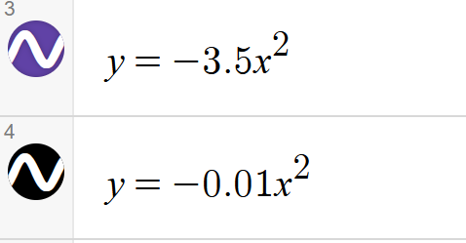
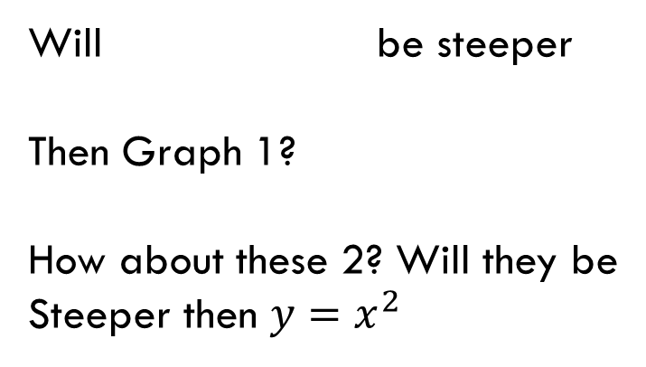
LHS:
Will be steeper
Then Graph 1?
How about these 2? Will they be
Steeper then ${y=x}^{2}$

Slide 10
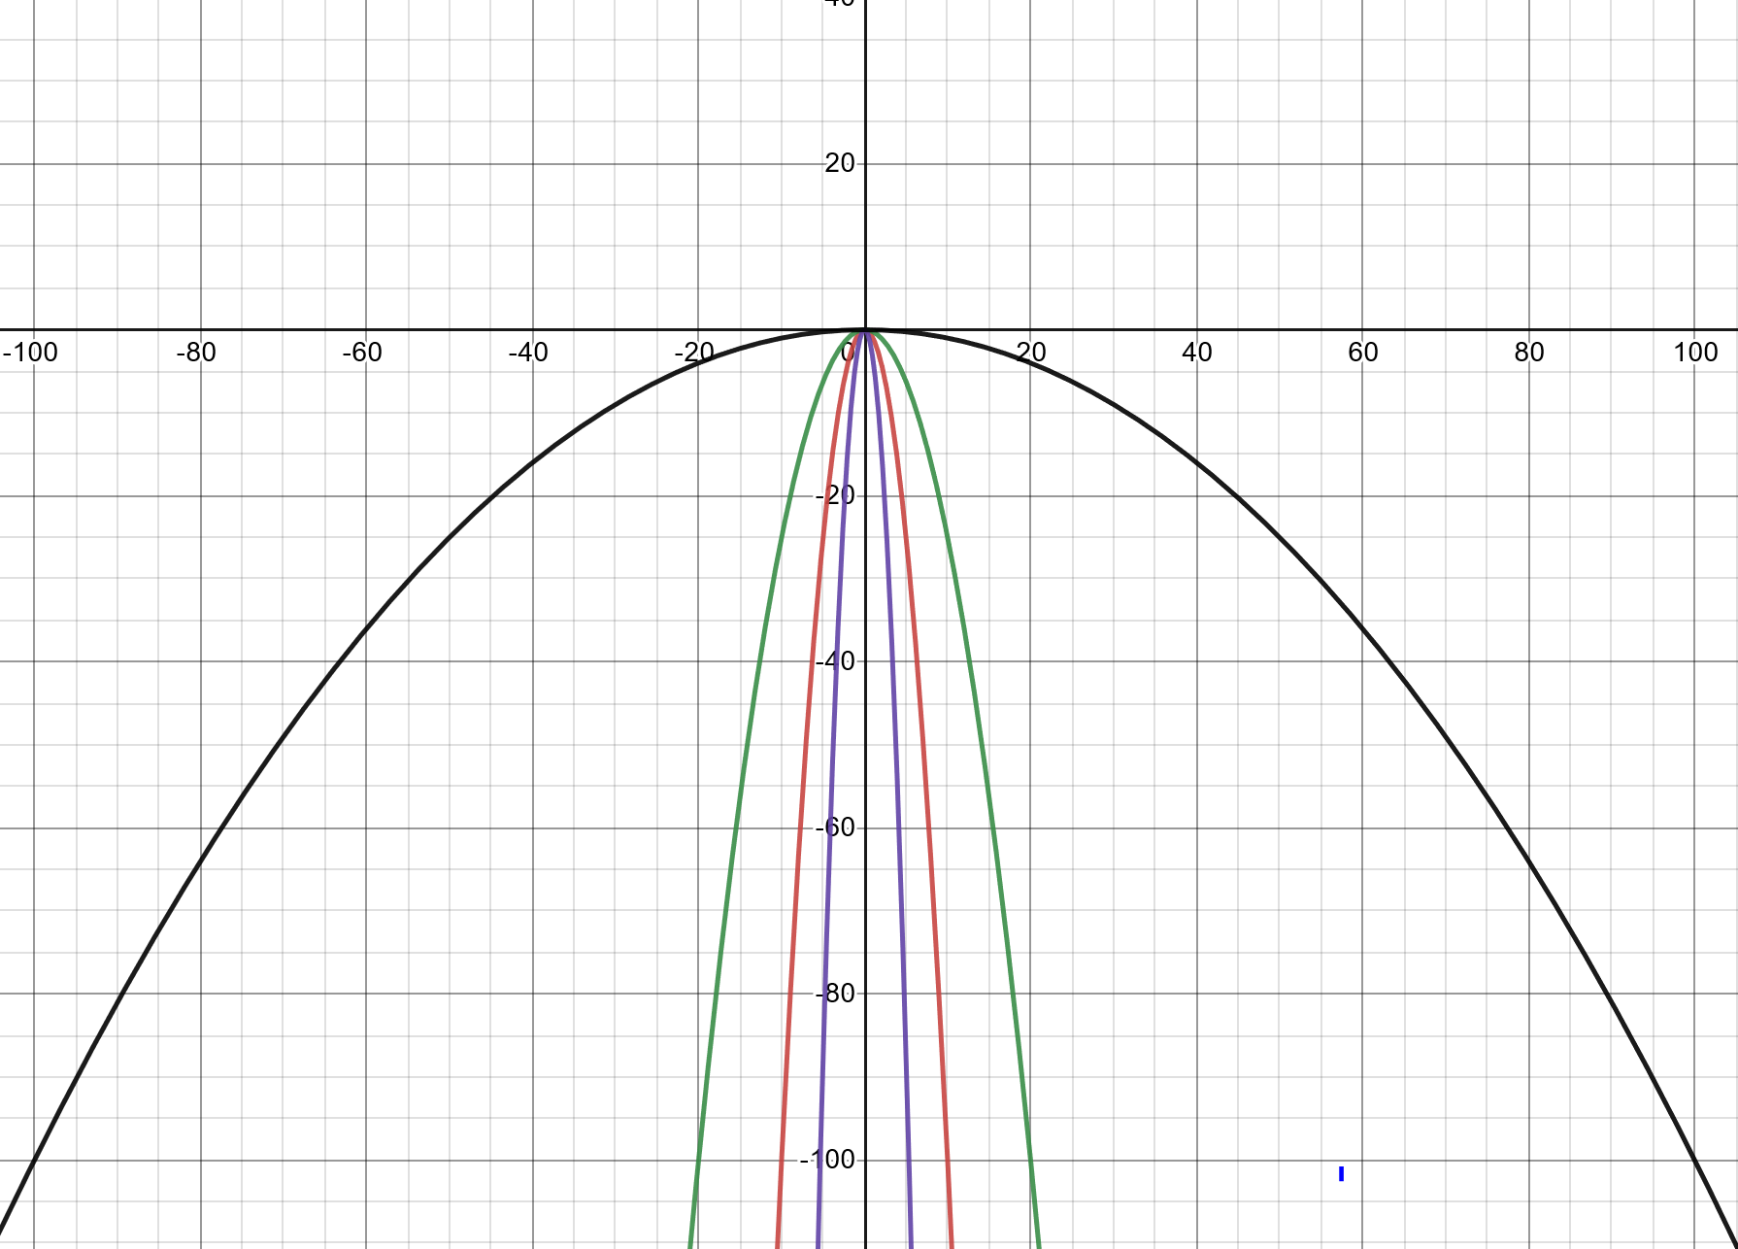
Solutions:

Slide 11
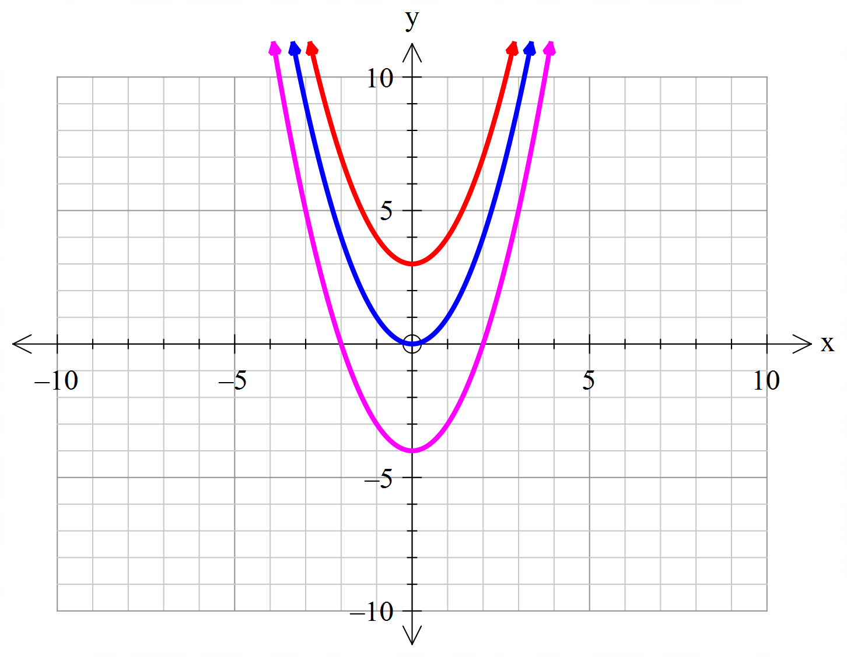


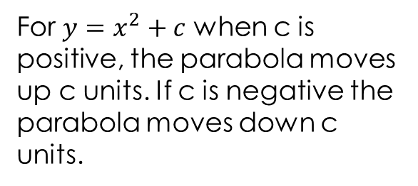

24
7
30
Topic: Quadratics
Date:
EQ – How can the parabola be transformed?
How do we move a parabola vertically?
$$y=x^{2}+3$$
For $y=x^{2}+c$ when c is positive, the parabola moves up c units. If c is negative the parabola moves down c units.
$$y=x^{2}$$
$$y=x^{2}−4$$

Slide 12
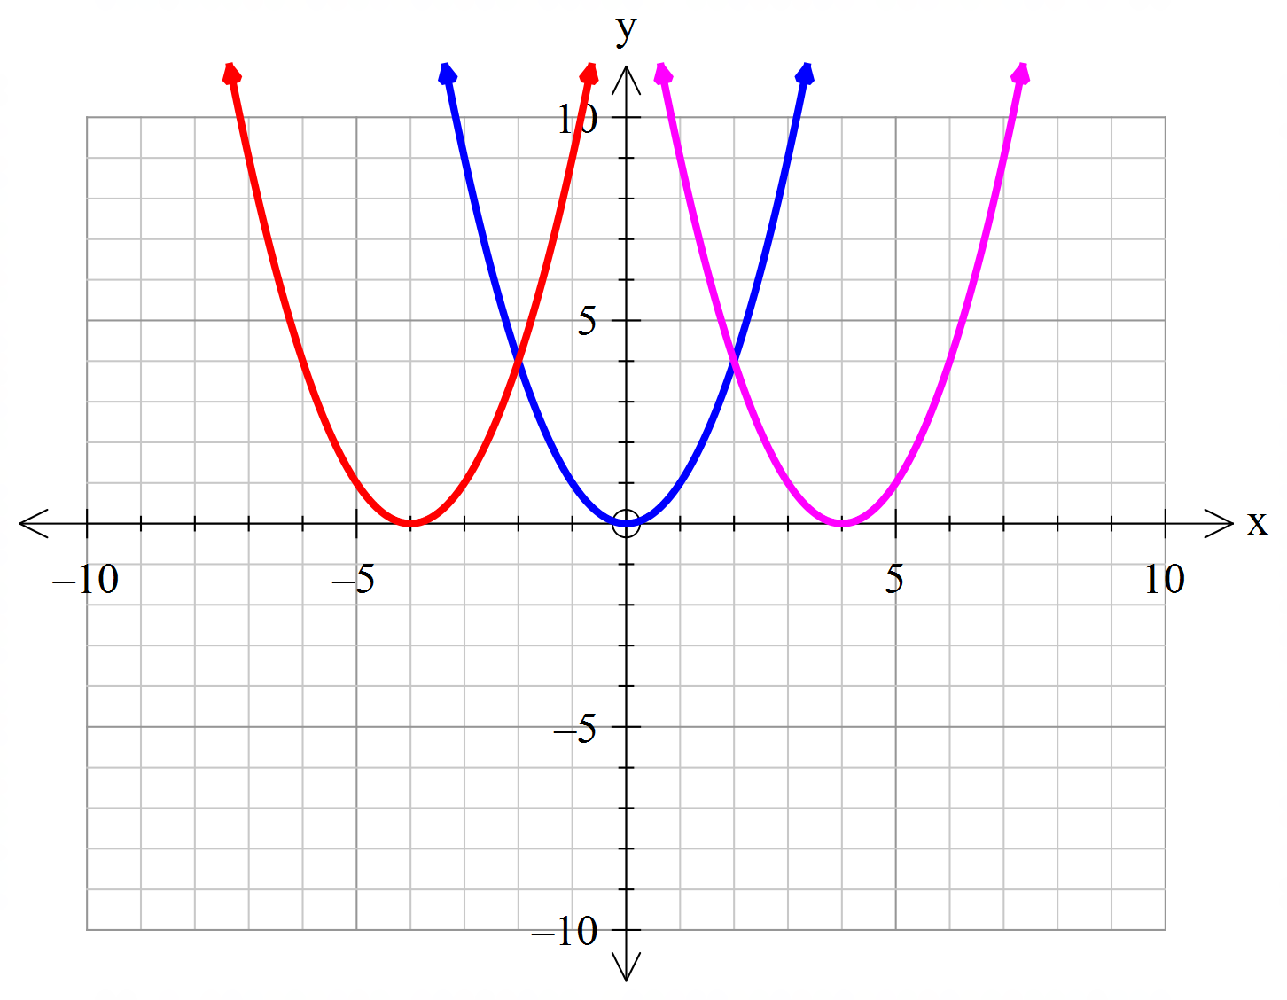


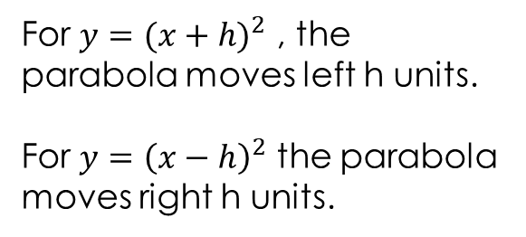

24
7
30
Topic: Quadratics
Date:
EQ – How can the parabola be transformed?
How do we move a parabola horizontally?
$$y={\left(x+4\right)}^{2}$$
$$y=x^{2}$$
For $y={(x+h)}^{2}$ , the parabola moves left h units.
For $y={\left(x−h\right)}^{2}$ the parabola moves right h units.
$$y={\left(x−4\right)}^{2}$$

Slide 13
24
7
30
Topic: Quadratics
Date:
EQ – How can the parabola be transformed?
How do we move a parabola horizontally?
$$y={\left(x+4\right)}^{2}$$
$$y=x^{2}$$
For $y={(x+h)}^{2}$ , the parabola moves left h units.
For $y={\left(x−h\right)}^{2}$ the parabola moves right h units.
$$y={\left(x−4\right)}^{2}$$

Slide 14


Slide 15
Task
Complete the Quadratics Transformation Worksheet

